Slide 1
“…you have to start with a beguiling and genuine narrative. You have to have a clear sense of yourself and what you want to stand for.” -Sue Hostetler, What Picasso Knew: Branding Tips For Artists From An Art Basel Insider (Forbes)

Slide 2
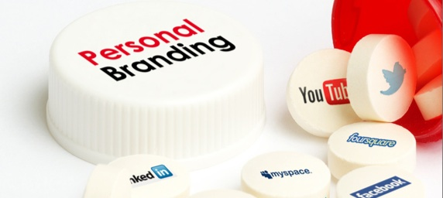
Building Your Personal Brand 10.19.15

Slide 3
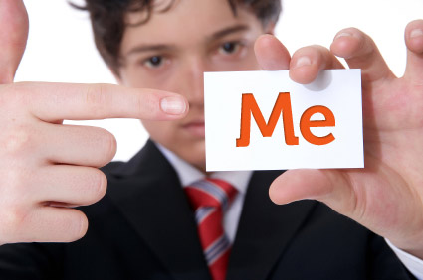
You are your best advocate. It’s time to be bold and deliberate about your work and career.

Slide 4

“The only difference between the professional salesmen and most people is the conscious effort it takes to be good at it.” – August Turak (Forbes Magazine)

Slide 5
The Path to Making a Conscious Effort to be Good at Selling Yourself is based on P.I.E.
10% Performance
30% Image
Performance
Image
Exposure
60% Exposure

Slide 6

Second
marketing
branding
First
Notes:
Marketing is the act of selling and promoting a brand. Marketing is the activity, set of institutions, and processes for creating, communicating, delivering, and exchanging offerings that have value for customers, clients, partners, and society at large. (Approved July 2013 – American Marketing Association)
Branding is the exercise of building an aesthetic representation of a brand.

Slide 7

Your brand is your promise to your customer. It tells them what they can expect from your products and services and it differentiates your offering from that of your competitors.
Your brand is derived from who you are, who you want to be and who people perceive you to be.
Source: http://www.entrepreneur.com/encyclopedia/branding
Notes:
A brand delivers an experience--- good or bad. It can be a product or service. It can be a person or culture.
Brands are formed with or without being deliberate.

Slide 8
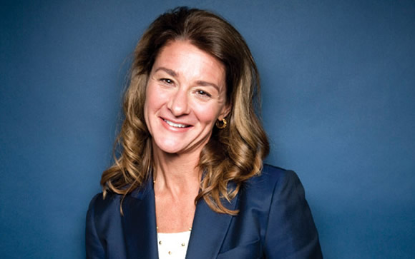
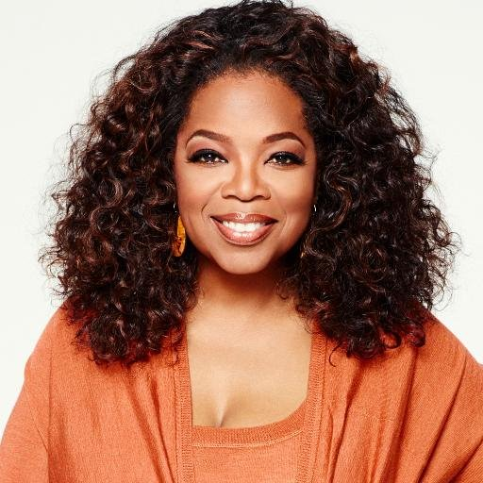
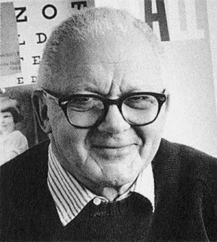
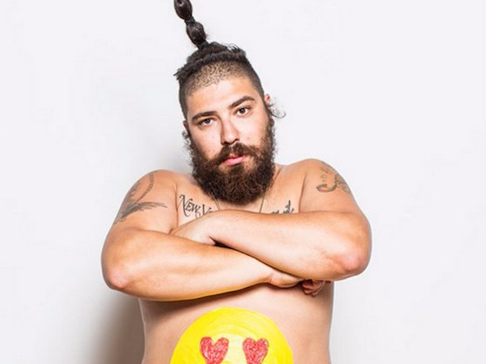

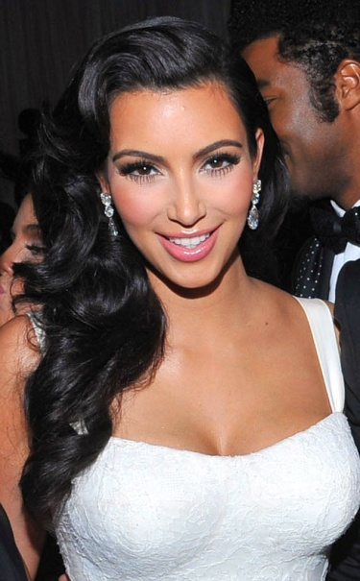
Paul Rand

Slide 9
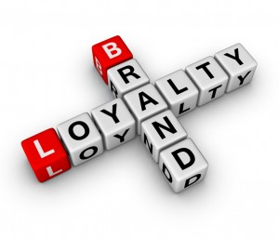
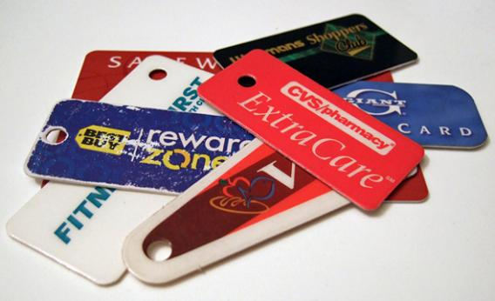
The Ultimate: Brand Loyalty
When consumers become committed to your brand and make repeat purchases over time. Brand loyalty is a result of consumer behavior and is affected by a person's preferences.
Loyal customers will consistently purchase products from their preferred brands, regardless of convenience or price.
Source: http://www.investopedia.com/terms/b/brand-loyalty.asp
Notes:
A brand delivers an experience--- good or bad. It can be a product or service. It can be a person or culture.
Brands are formed with or without being deliberate.

Slide 10
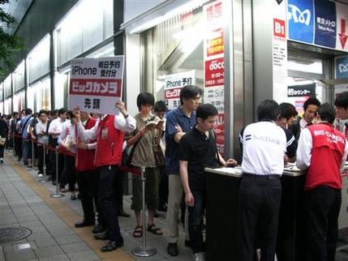
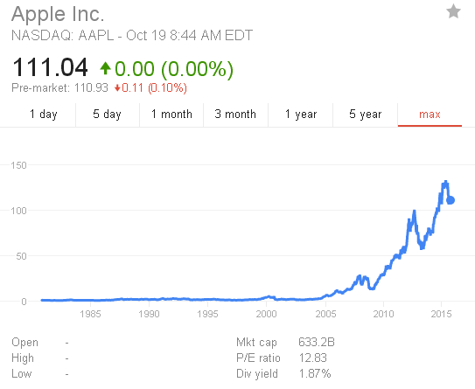
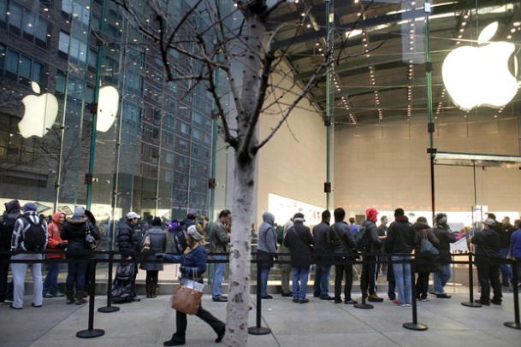
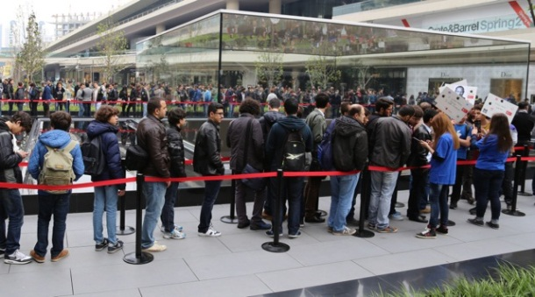
The Ultimate: Brand Loyalty
Japan
United States
iPhone Launched in 2007
Istanbul
Notes:
When consumers become committed to your brand and make repeat purchases over time. Brand loyalty is a result of consumer behavior and is affected by a person's preferences. Loyal customers will consistently purchase products from their preferred brands, regardless of convenience or price. Companies will often use different marketing strategies to cultivate loyal customers, be it is through loyalty programs (i.e. rewards programs) or trials and incentives (ex. samples and free gifts).

Slide 11
Time to tighten or build your brand identity…
Pathway to Building a Brand
Target Consumer
What Matters to Your Consumer?
How are (can) you deliver what matters?
Marketing Research
Functional Promise
Emotional Promise
Brand Promise
Brand Story

Slide 12

Workshop Exercise:
List 3 to 5 questions to help you better understand your strategic target (consumer).
Who do you think your strategic target is? How do you know?
Start building and thinking through a personal brand profile.

Slide 13
Brand Profile
PROPOSITION
Strategic Target: | Who are you going after?
Functional Promise: | What literal benefit will they get from your product / service?
Emotional Promise: | How will your product / service make them feel?
Brand Promise: | Their overall experience with your brand.
 | Performance | Imagery & Values | Symbols & Associations
 | Core Themes | Core Themes | Logo
SUPPORT
13

Slide 14

Building Your Brand is all about FOCUS & DIFFERENTIATION

Slide 15

Gaining Exposure is linked to having an ACTIVE & ENGAGED NETWORK
Where are you?
Where is everyone else?
Where are your customers?
Are you consistent?
Are you memorable?
Are you asking?

Slide 16
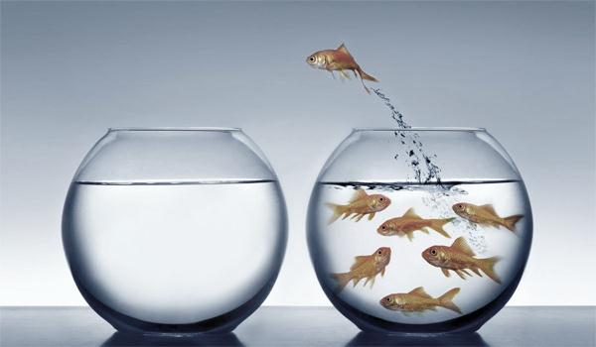
Challenges:
Getting Started
Casting Your Net Wider
Closing the Deal

Slide 17
Getting Started– Stand out with purpose.
The Basics: LinkedIn, Facebook, Instagram, Vimeo, Twitter, other niche social media networks, networking events, professional memberships, volunteer projects with High exposure, tiered pricing approach, etc.
Casting a Wider Net– Think unconventional.
Where is your target? How can you meet them?
Write an article, send a recommendation, develop a YouTube channel highlighting your work or critiquing work.
Closing the Deal– Always have an ask.
Get to the point quickly-- 90 second pitch
Establish clear next steps and timelines
Once a project is complete ask for recommendations, referrals, and quotes for use in your marketing material.
Personal touches matter.
Make a plan with key benchmarks.

